Slide 1

Methodology

Slide 2




County Data Aggregation
Aggregate all the data possible into one giant data table
Perform the county selection process
For each county, filter that data and transpose it from wide to long data then group by month
Pull the time series climate data for each county from the climate data in ArcMap
Merge the climate data and case data in R and write a file for each county

Slide 3
The State of the Data
Example of Data from Pima, Arizona
Month | Year | Total New Cases | Temperature | Soil Moisture | Precipitation
1 | 2020 | 0 | 266.551117 | 0.21569824 | 0.00195767
2 | 2020 | 0 | 272.083618 | 0.33831787 | 0.00117531
3 | 2020 | 202 | 276.732635 | 0.39414978 | 0.00332341
4 | 2020 | 1039 | 283.822433 | 0.29469299 | 0.00117324
5 | 2020 | 1127 | 291.20546 | 0.08180237 | 0.00049297
6 | 2020 | 5636 | 298.316925 | 0.02656555 | 6.4993E-05
7 | 2020 | 8163 | 298.688828 | 0.02816772 | 0.0001714
8 | 2020 | 5054 | 298.185226 | 0.04516602 | 0.00071669
9 | 2020 | 4407 | 293.498795 | 0.02424622 | 5.2507E-07
10 | 2020 | 2970 | 286.173187 | 0.02497864 | 3.9767E-07
11 | 2020 | 11261 | 278.698593 | 0.14277649 | 0.00105689
12 | 2020 | 29663 | 273.104004 | 0.19335938 | 0.00034601

Slide 4



County Data Analysis
Perform multiple linear regressions in program of choosing (Excel, R, and STATA) for each county individually
Analyze the obtained results

Slide 5

Results & Analysis

Slide 6
Quick Facts
County | R² | Temperature P-Value | Soil Moisture P-Value | Precipitation P-Value
Pima, Arizona | 0.26790686 | 0.33439462 | 0.97643934 | 0.26287927
San Francisco, California | 0.21277399 | 0.30105978 | 0.40027999 | 0.71632608
Miami–Dade, Florida | 0.37350872 | 0.25076117 | 0.52415012 | 0.21225603
Tift, Georgia | 0.08011189 | 0.6006376 | 0.48833484 | 0.54666331
Cook, Illinois | 0.76268884 | 0.00691822 | 0.00160986 | 0.22655311
Richland, Louisiana | 0.11374961 | 0.36307953 | 0.55731974 | 0.45032471
New York, New York | 0.39831268 | 0.88800433 | 0.17927839 | 0.98352732
Medina, Ohio | 0.61505672 | 0.00826739 | 0.03470477 | 0.03327895
Spartanburg, South Carolina | 0.30933901 | 0.10048437 | 0.19534938 | 0.2135677
Marion, Texas | 0.38347787 | 0.93600009 | 0.10936241 | 0.0895341

Slide 7
Quick Facts
County | R² | Temperature P-Value | Soil Moisture P-Value | Precipitation P-Value
Pima, Arizona | 0.26790686 | 0.33439462 | 0.97643934 | 0.26287927
San Francisco, California | 0.21277399 | 0.30105978 | 0.40027999 | 0.71632608
Miami–Dade, Florida | 0.37350872 | 0.25076117 | 0.52415012 | 0.21225603
Tift, Georgia | 0.08011189 | 0.6006376 | 0.48833484 | 0.54666331
Cook, Illinois | 0.76268884 | 0.00691822 | 0.00160986 | 0.22655311
Richland, Louisiana | 0.11374961 | 0.36307953 | 0.55731974 | 0.45032471
New York, New York | 0.39831268 | 0.88800433 | 0.17927839 | 0.98352732
Medina, Ohio | 0.61505672 | 0.00826739 | 0.03470477 | 0.03327895
Spartanburg, South Carolina | 0.30933901 | 0.10048437 | 0.19534938 | 0.2135677
Marion, Texas | 0.38347787 | 0.93600009 | 0.10936241 | 0.0895341

Slide 8
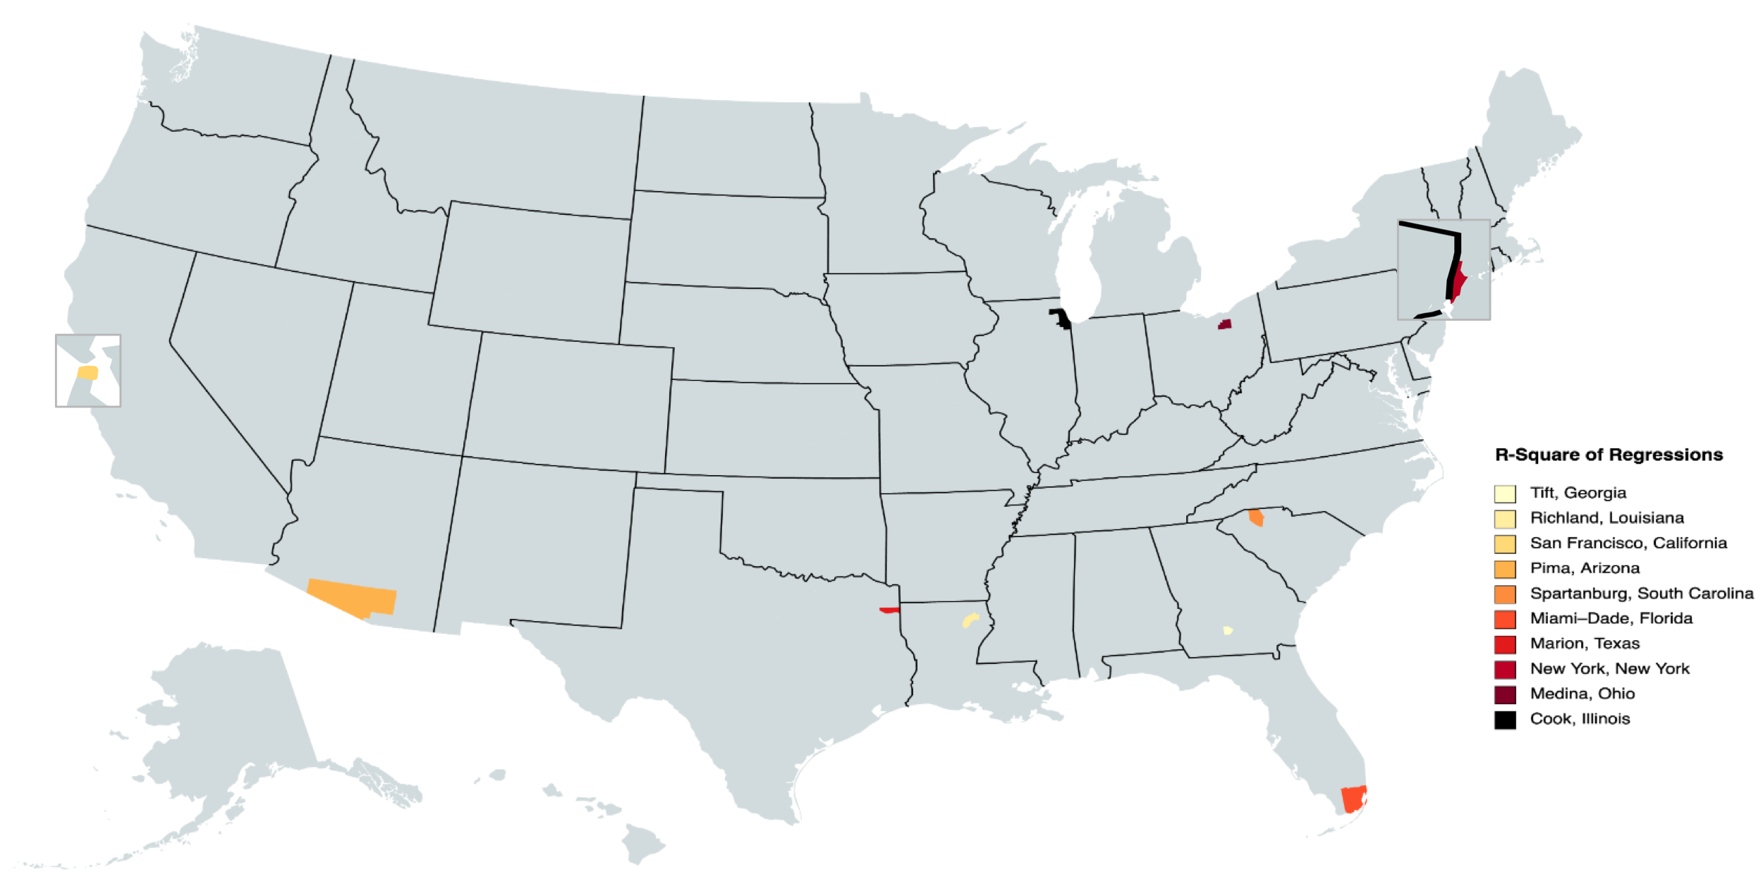
Map of Selected Counties Colored by R² Value

Slide 9
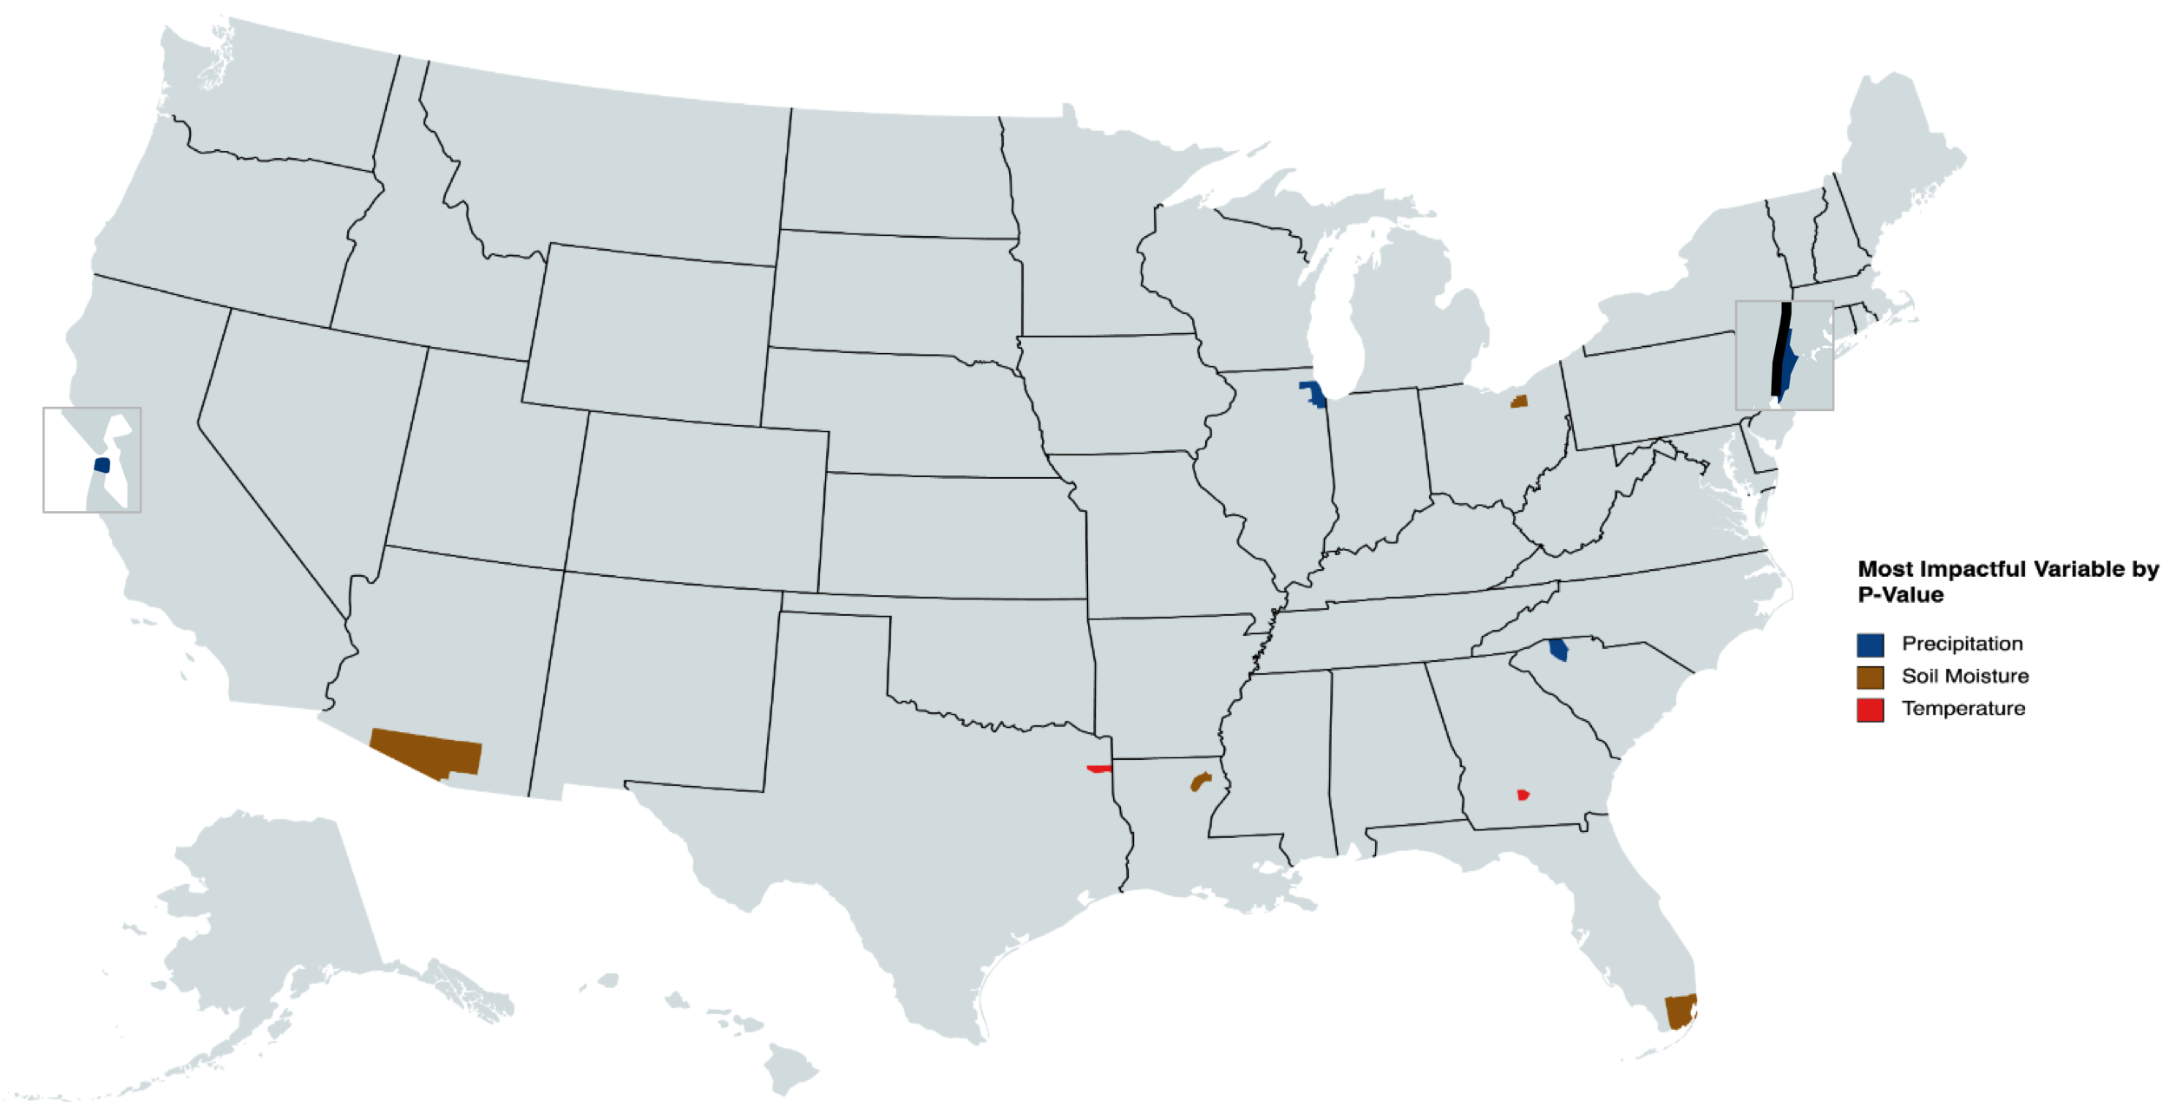
Map of Selected Counties Colored by the Most Impactful Variable by P-Value

Slide 10

Conclusions

Slide 11






Conclusion 1
Climate variables such as temperature, precipitation, and soil moisture can be good influential factors of COVID-19 virus spread
The results indicate that this works better for some counties than others

Slide 12
Conclusion 2
Although the counties affected most by precipitation are in the north and those affected by soil moisture and temperature are in the south, there is not enough data to form a conclusion

Slide 13

Next Steps

Slide 14


Incorporate Vaccination Data
As the vaccine rollout continues and the number of vaccinated stabilize, we will be able to better forecast future outbreaks provided the vaccines provide similar levels of protection against future variants

Slide 15


Forecasting and Cross-Validation
Cross-Validation allows us to forecast on data we already have
Forecasting future COVID-19 cases helps combat the pandemic

Slide 16


Perform More Advanced Regressions
With geographically weighted regressions, we can see if placement in the country has any effect
We will also be able to make forecasts for all counties, rather than specific counties

Slide 17

Obstacles

Slide 18



Technological and Resource Challenges
Took a long time to set up and learn the basics of ArcGIS
Challenges with file sharing and dataset storage especially with regards to remote work
GitHub provides lots of opportunity, but severely limits file sizes
Data on masking and social distancing is not very complete

Slide 19



Knowledge
I’ve never used ArcGIS before and it has a very steep learning curve
I’ve never worked with panel data before in any capacity
Time series data for multiple items (i.e. counties)
Some file types are harder to work with and not well supported by familiar tools (R, Excel, or Stata)

Slide 20

Acknowledgements

Slide 21

National Science Foundation
Funding came from the National Science Foundation Undergraduate Research Opportunity Grant #1852042

Slide 22

University of Tennessee at Chattanooga
This REU was organized and supported by the University of Tennessee at Chattanooga
Special thanks to Dr Hong Qin, Principal Investigator of the iCompBio REU program

Slide 23
Research Mentor and Supporting Staff
Dr Azad Hossain, without whom this project would not be possible and to who I am forever grateful for being so patient with me and helping me learn
Nyssa Hunt from the IGTLab at UTC who helped me through many ArcGIS problems

Slide 24

Investigating the potential impact of climate variables on the spread of sars-cov-2 (covid-19) in the united states
Gus Lipkin, Florida Polytechnic University
A.K.M. Azad Hossain, Assistant Professor, University of Tennessee at Chattanooga

